Slide 1
Why JAX and Flax NNX? A High-Performance, Flexible Platform for Advanced Computation
Leveraging composable transformations, modern hardware, and a Pythonic neural network API for demanding AI/ML and scientific workloads
Notes:
Today, we’re going to explore the strengths of JAX and Flax NNX, a powerful combination for tackling complex computational challenges. We’ll see how JAX provides a high-performance foundation using function transformations and modern hardware, and how Flax NNX offers a user-friendly way to build neural networks on top of JAX, making this an ideal combination for advanced AI, machine learning, and scientific computing.

Slide 2

Developer Love
“There’s a sense of tranquility when I nuke my code and rewrite it in JAX. Not only does it become faster, all my horrible code is rewritten better”
- Stone Tao (UCSD, Co-Founder of Lux AI Challenge)
Source: https://twitter.com/Stone_Tao/status/1555394550092353537
Notes:
We’ve heard from the community that they recognize and appreciate JAX. Here’s a quote.

Slide 3
Why did Google develop JAX?
Google learned from years of experience
DistBelief
TensorFlow
Google needed high performance to scale efficiently
Google needed flexibility and modularity to innovate quickly
High performance, flexibility, and modularity became the guiding principles for the development of JAX
Notes:
Google developed JAX because Google needed JAX. We learned from years of experience in ML and then AI, and successive generations of frameworks, starting with DistBelief and then TensorFlow. Google needs high performance to work at massive scales with huge models and datasets. Google also needs a framework that is flexible and modular in order to innovate quickly for both research and production use cases. So high performance, flexibility, and modularity became the guiding principles for the development of JAX.

Slide 4
Performance: JAX versus NumPy
def jax_batch(W, b, x):
for i in range(10000):
result = jax_predict(W, b, x)
return 0
def np_batch(W, b, x):
for i in range(10000):
result = np_predict(W, b, x)
return 0
jit_predict = jax.jit(jax_batch)
Colab CPU Instance:
NumPy: np_batch(W, b, x)
92.7 ms ± 22.7 ms per loop
JAX (with compile): jit_predict(W, b, x)
34.6 µs ± 41.8 µs per loop
JAX (after compile): jit_predict(W, b, x)
17.3 µs ± 6.83 µs per loop
~5,300X speedup versus NumPy
Notes:
How good is the performance? This comparison between JAX and NumPy on a free Colab CPU instance shows about a 5,300X speedup.

Slide 5
Performance: NNX versus PyTorch
def nnx_batch(W, b, x):
for i in range(10000):
result = nnx_predict(W, b, x)
return 0
def pt_batch(W, b, x):
for i in range(10000):
result = pt_predict(W, b, x)
return 0
nnx_jit_predict = nnx.jit(nnx_batch)
Colab CPU Instance:
PyTorch: pt_batch(W, b, x)
82.2 ms ± 18.8 ms per loop
NNX (with compile): nnx_jit_predict(W, b, x)
83.1 µs ± 76.3 µs per loop
NNX (after compile): nnx_jit_predict(W, b, x)
37.2 µs ± 1.42 µs per loop
~2,200X speedup versus PyTorch
Notes:
NNX is our new neural network framework. We’ll talk about NNX in a bit. This comparison between NNX and PyTorch on a free Colab CPU instance shows about a 2,200X speedup. I’d say that’s pretty good!

Slide 6
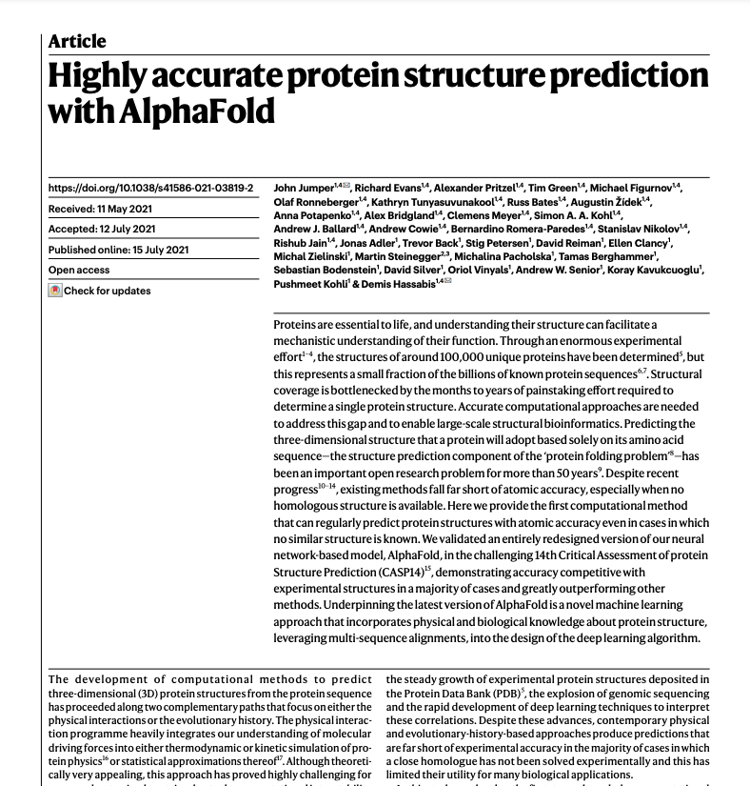
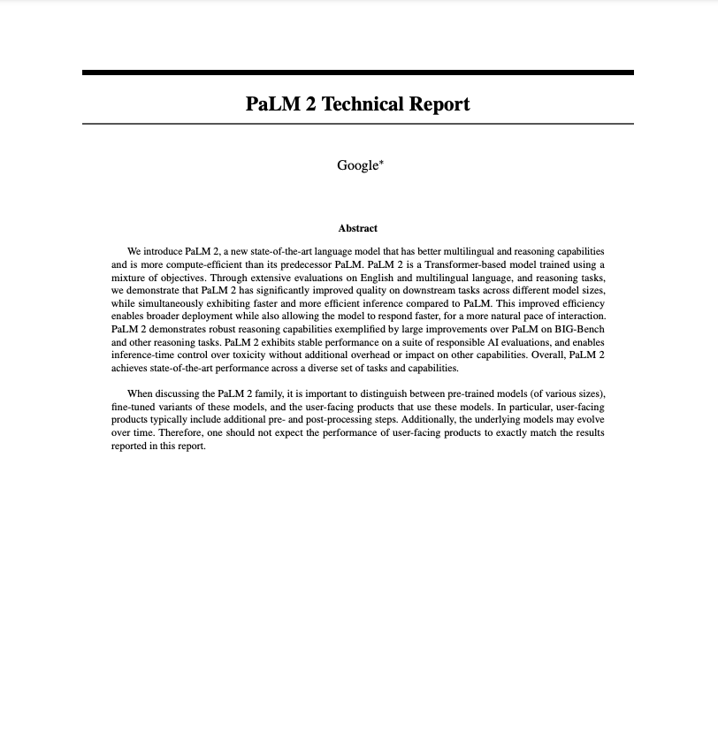
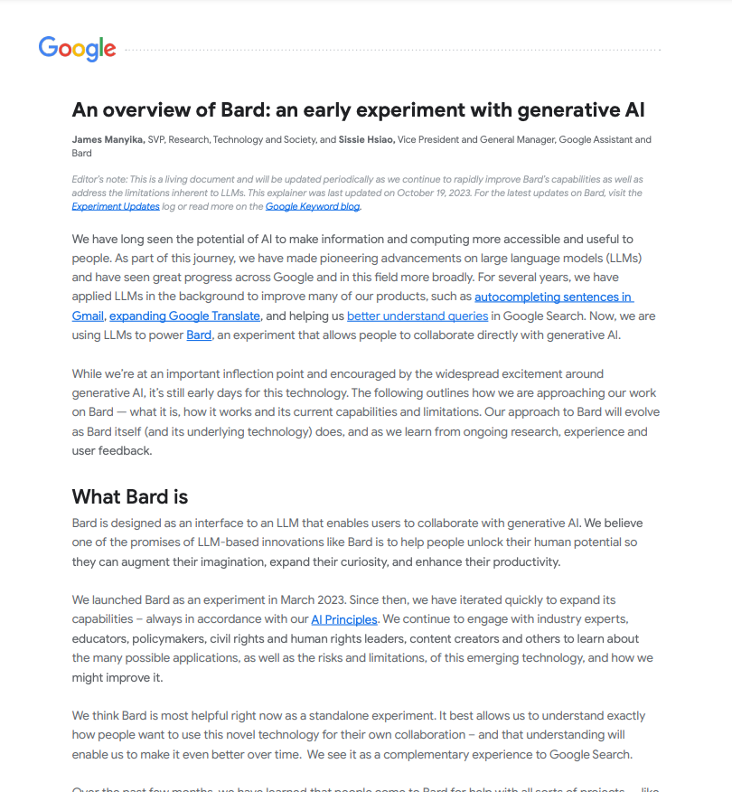
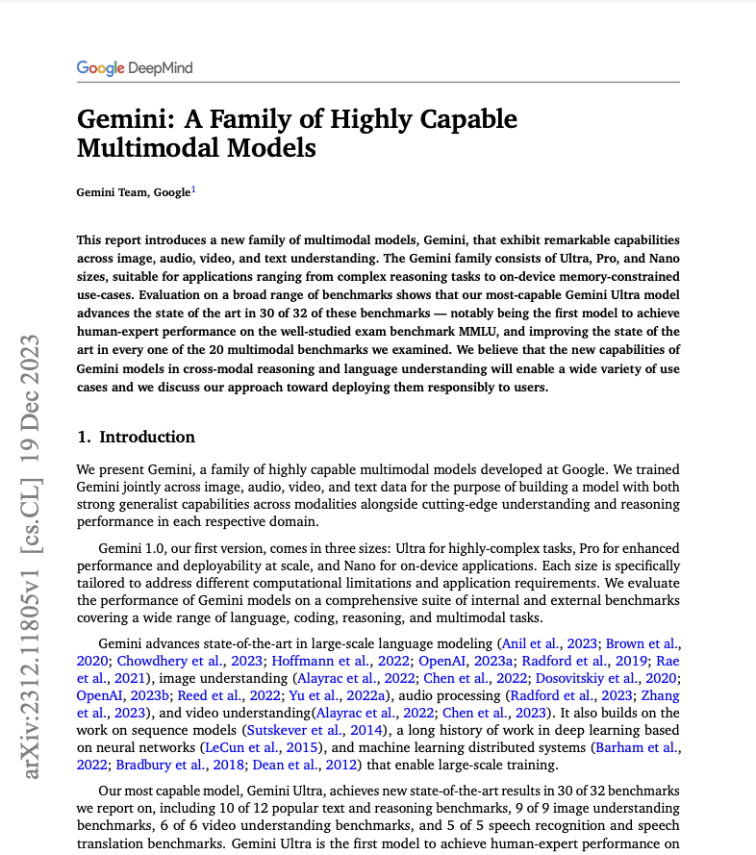
Flexibility and Modularity
You’ve seen results generated with JAX
Google uses JAX for nearly all of its research and GenAI development
Gemini, Gemma, Imagen, Veo, Waymo, etc. are all created using JAX
Notes:
Nearly all of the AI and scientific research that Google and DeepMind do is done using JAX. That includes both Gemini, Gemma, Imagen, Veo, etc. There are good reasons for that.

Slide 7
JAX: High-Performance Foundation
Accelerated Numerical Computing: JAX is a platform built on Python and NumPy syntax, designed for high performance on accelerators like GPUs and TPUs.
Function Transformations: Its core power lies in composable function transformations (jit(), grad(), vmap()) that automatically differentiate, compile, and vectorize standard Python code.
Beyond ML: While powerful for ML, JAX is also a foundational library for any domain requiring accelerated numerical operations.
Notes:
Let's start with JAX itself. Think of JAX not just as another library, but as a high-performance platform for numerical computing in Python. It builds on the familiar syntax of Python and NumPy but adds powerful capabilities through composable function transformations – jit(), grad(), vmap(), and shard_map(). These allow JAX to automatically optimize your standard Python code for accelerators like GPUs and TPUs. And while it's widely used in machine learning, its core strengths make it valuable for any field needing fast numerical computation.

Slide 8
JAX Strength: Scalability & Portability
Designed for Scale: Engineered for speed on single devices and scalability across multiple devices.
Simplified Distributed Parallelism: Leveraging XLA, distributing computations often involves minimal boilerplate; users specify data partitioning (sharding), and XLA handles communication/synchronization.
Notes:
JAX isn't just fast on one GPU or TPU, it's designed to scale. Thanks to the underlying XLA compiler, distributing computations across multiple devices often requires surprisingly little extra code compared to some other frameworks. You tell JAX how to split or 'shard' your data, and XLA handles the complex parts of coordinating the work and the communication between devices.

Slide 9
JAX Strength: Scalability & Portability
Automatic Scaling: Code often scales effectively across different hardware configurations (e.g., single GPU to TPU pods) with minimal changes, as XLA adjusts the execution plan.
Hardware Agnosticism: JAX code typically runs without modification on CPUs, NVIDIA GPUs, and Google TPUs, thanks to XLA abstracting hardware specifics.
Notes:
This also means your code often scales well automatically – run the same code on more devices, and XLA adapts. Plus, JAX provides excellent portability. Code you write can typically run across CPUs, NVIDIA GPUs, and Google TPUs without modification, because XLA handles the hardware specifics.

Slide 10
Developer Love
“I used to write custom CUDA kernels and optimize my code to stuff large GNNs into GPU memory. So I decide to profile some common GNN operations with JAX and PyTorch. It turns out that the JIT of JAX always outperforms PyTorch in both time and mem.”
- Zhaocheng Zhu (PhD @ MilaQuebec)
Source: https://twitter.com/zhu_zhaocheng/status/1656372666582827008
Notes:
We’ve heard from the community that they recognize and appreciate the performance of JAX. Here’s another quote.

Slide 11
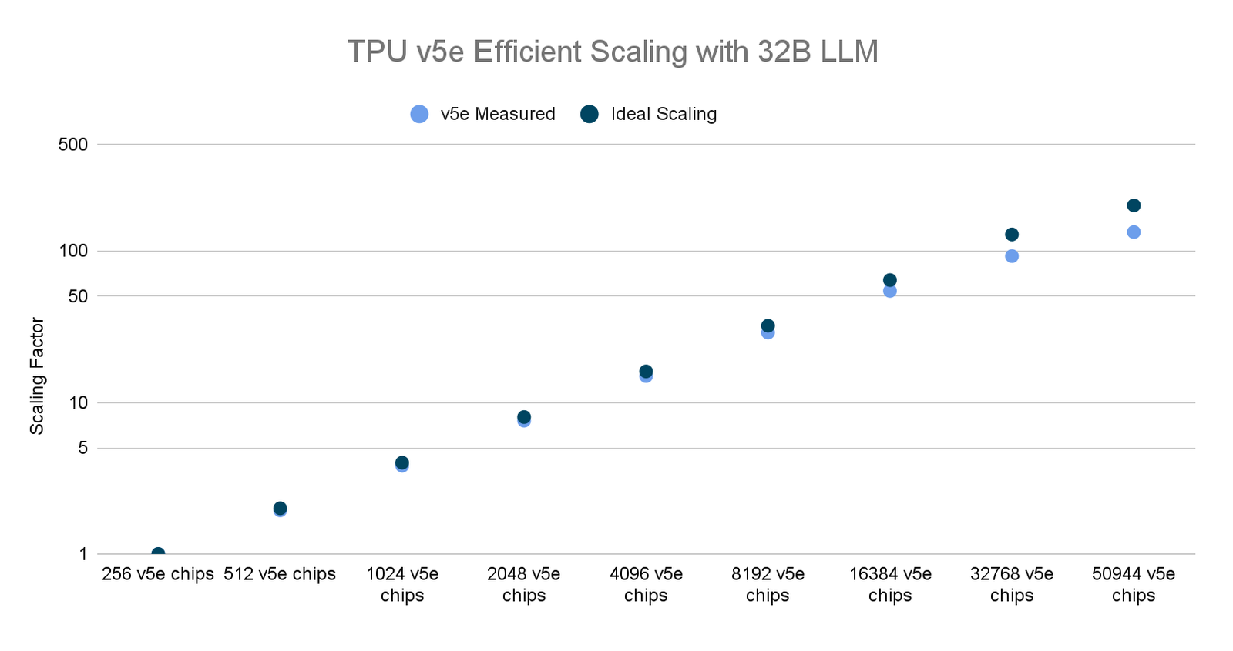
JAX Scalability: Scaling to 50,944 TPUs with JAX
JAX Scalability: TPUs
In November 2023, we used Multislice Training to run an extremely large LLM distributed training job
50,944 Cloud TPU v5e chips (spanning 199 Cloud TPU v5e pods)
Near ideal scaling
Source: https://cloud.google.com/blog/products/compute/the-worlds-largest-distributed-llm-training-job-on-tpu-v5e
Notes:
Scalability is incredibly important for any kind of production AI, and JAX shows near ideal scalability. Here’s a November 2023 study which showed near perfect scaling to over 50,000 TPUs.

Slide 12
Notes:
Let’s take a closer look at that graph. You can see at the very upper end it diverges slightly from ideal, linear scaling. That’s a big deal.

Slide 13
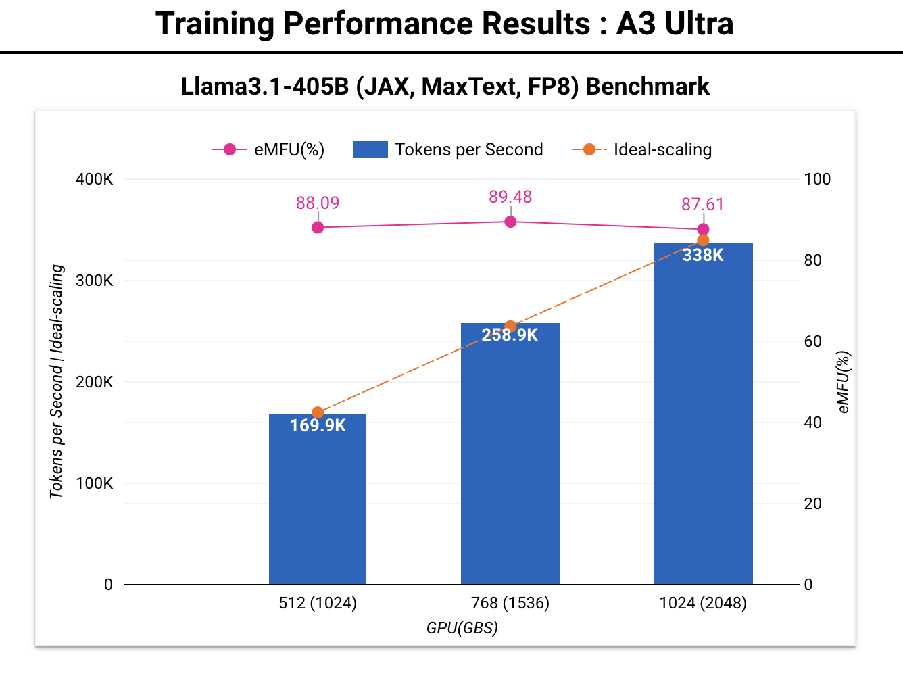
JAX Scalability: GPUs
High Performance at Scale
> 80% EMFU FP8 at 1000 NVIDIA GPU scale
Near linear scaling upto 1024 GPU scale
MaxText + JAX/XLA stack allows ease of performance optimization
Close partnership with NVIDIA
Reproducible recipes https://github.com/AI-Hypercomputer/gpu-recipes/
seq-len=8192. emfu= (observed flops throughput/bf16 peak flops). Google internal data for A3 Ultra as of February, 2025. Performance numbers subject to continuous updates
Notes:
On GPUs, you can see the benchmark here showing state of the art training performance for LLAMA3 405B using FP8 training on A3 Ultra, which is based on Nvidia’s H200. As you can see in the graph, we are able to scale near linearly at very high performance up to at least 1024 GPUs. We use a metric called EMFU which is effective model flops utilization, which is the ratio of utilized FP8 flops divided by the peak BF16 flops, and we achieve >80% EMFU (which is state of the art performance at this scale). We are able to achieve this kind of performance at scale because of our close partnership with Nvidia, as well as the core tenets of JAX, which is designed for performance.

Slide 14
Developer Love
“Personally, I've decided to switch to JAX due to its modern approach to parallelism, which can be automatic or semi-automatic. The JAX compiler takes care of many demanding tasks, such as managing the communication of activations and gradients.”
- Luyu Gao (PhD candidate @CarnegieMellon)
Source: https://twitter.com/luyu_gao/status/1768276177448567142
Notes:
Developers have also told us that they also appreciate JAX’s modern approach to parallelism. Here’s yet another quote.

Slide 15
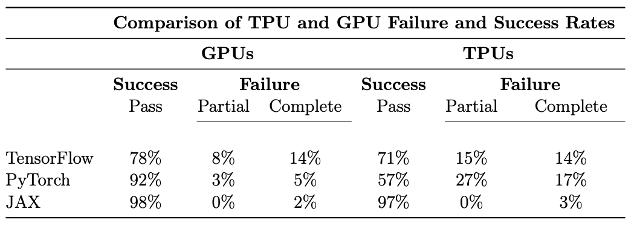
Hardware Portability: JAX v PyTorch v TF Failure Rates
Source: The Grand Illusion: The Myth of Software Portability and Implications for ML Progress (Cohere/MIT Sept 2023)
Notes:
Portability across accelerators can be important for a number of reasons, including the ability to train on one set of hardware and run inference on different hardware, with minimal code changes if any. This is common for example in autonomous vehicle applications, edge and mobile, and robotics, where onboard hardware is limited.
A 2023 study by Cohere and MIT demonstrated the benefits of XLA in terms of hardware portability. As you can see, their study demonstrated that JAX had the highest success rates and lowest failure rates across both GPUs and TPUs.

Slide 16
Flax NNX
Notes:
Now let’s talk about Flax NNX.

Slide 17
Flax NNX: Intuitive Neural Network Development
Modular, layered design
Flax NNX
Neural network library for JAX that is designed for ease of use
Orbax
Checkpointing and export
Optax
Gradient processing and optimization
Flax NNX | Orbax | Optax
JAX
XLA
CPU/GPU/TPU
Notes:
The JAX AI Stack is built with a modular, layered architecture. JAX itself builds on XLA, and the other libraries in the stack build on JAX. These are the same libraries that DeepMind uses. We’ll focus now on Flax NNX, a library for building neural networks that is designed to be Pythonic, familiar, and relatively easy to use.

Slide 18

Flax NNX: Intuitive Neural Network Development
Modern JAX API: Flax NNX is a neural network library within the Flax ecosystem, specifically designed for JAX.
Simplified & Flexible: Introduced in 2024, NNX is engineered for simplicity, flexibility, and an enhanced developer experience, making it easier to create, inspect, debug, and analyze models.
First-Class Pytree Integration: NNX Modules are now native JAX Pytrees, allowing direct use with jax.jit, jax.vmap, and other transformations.
Builds on Experience: Incorporates learnings from previous JAX libraries for a more user-friendly interface.
Notes:
Flax is a popular neural network library for JAX, and NNX is its modern API, introduced in 2024. NNX was explicitly designed to make building neural networks in JAX simpler, more flexible, and more intuitive for the developer. It aims to streamline the process of creating, inspecting, and debugging models, building on the experience gained from earlier JAX libraries.

Slide 19
Developer Love
“The jit'd JAX (Flax in this case) impl ran circles around familiar PyTorch and TF impl of similar algos (CPU or GPU). And that's without taking the time to vectorize the eval envs. I was using https://github.com/ikostrikov/jaxrl as my starting point.”
- Ross Wightman
Source: https://twitter.com/wightmanr/status/1417616247118733313
Notes:
And Flax is also fast, as developers have recognized. Here’s another quote.

Slide 20
Flax NNX Strength: Pythonic Design
Familiar Object Semantics: Embraces standard Python object concepts like classes, inheritance, attributes, methods, and reference semantics. Allows natural patterns like weight sharing.
Intuitive Module Definition: Define layers/models by subclassing nnx.Module, defining sub-layers as attributes in __init__, and logic in __call__. Uses standard layers like nnx.Linear, nnx.Conv, nnx.BatchNorm, etc.
Seamless JAX Integration: As native Pytrees, NNX modules work directly with JAX's function transformations.
Easier Adoption: Lowers the barrier for developers familiar with object-oriented frameworks (like PyTorch/Keras) to leverage JAX.
Notes:
A key strength of NNX is its Pythonic design. It uses standard Python object semantics – think classes, attributes, methods, and even standard reference sharing, which is great for things like sharing weights between layers. You define your network components by subclassing nnx.Module, setting up layers like Convolutions, Linear layers, or Batch Normalization as attributes in the __init__ method, and defining the forward pass in the __call__ method – a pattern familiar to many Python programmers. This makes NNX feel very natural. A key part of this is that NNX modules are now native Pytrees, so they integrate seamlessly with JAX's core transformations. This significantly lowers the learning curve for developers coming from object-oriented frameworks who want to tap into JAX's power.

Slide 21
JAX Ecosystem
Notes:
Now let’s take a look at the JAX ecosystem. It’s not as big as either the PyTorch or TensorFlow ecosystems, but it’s growing fast.

Slide 22
JAX Ecosystem: Breadth & Flexibility
Large and Growing: A major strength is the large, diverse ecosystem of libraries, tools, and projects built upon JAX.
Testament to Power: This vibrant activity showcases JAX's flexibility and applicability across a wide array of domains, far beyond conventional deep learning.
Modular Philosophy: JAX core remains lean, encouraging domain-specific innovation in independent libraries.
Curated Neural Network Stack: The JAX AI Stack provides a tested set of core libraries (JAX, Flax, Optax, Orbax) for compatibility and easier onboarding.
Notes:
Beyond JAX core and Flax NNX, one of the biggest advantages is the rapidly growing ecosystem surrounding JAX. There's already a huge number of libraries and projects built on JAX, which really speaks to its power and flexibility across many different fields, well beyond typical deep learning tasks. This is partly due to JAX's modular design, where the core is kept lean and clean, allowing specialized communities to build on top. For those looking for a stable starting point for AI development, the JAX AI Stack offers a curated set of core libraries that are tested to work well together.

Slide 23
JAX Ecosystem: Representative Examples
Neural Networks: Flax NNX, Equinox, Penzai, Scenic, Objax, EasyDeL.
Foundation Models: MaxText, Levanter, EasyLM, Marin.
Reinforcement Learning: RLax, BRAX (physics), gymnax (envs), Jumanji (envs), Mctx (search), Pgx (games).
Probabilistic Programming: NumPyro, Oryx, Distrax, BlackJAX (samplers), GPJax (Gaussian Processes).
Notes:
Here’s just a taste of the ecosystem's breadth. You can see dedicated libraries for various neural network approaches beyond Flax NNX, like Penzai and Equinox. There are specialized toolkits for training large foundation models, extensive libraries for reinforcement learning including environments and algorithms, and powerful tools for probabilistic programming and Bayesian modeling.

Slide 24
JAX Ecosystem: Representative Examples
Scientific Computing: JAX M.D. (molecular dynamics), NetKet (quantum physics), jax-cosmo (cosmology), Diffrax (diff eq solvers), delta PV (photovoltaics), dynamiqs (quantum dynamics), XLB (fluid dynamics).
Optimization: Optax, JAXopt, Optimistix.
Utilities: Chex (testing), Orbax (checkpointing), SafeJax (serialization).
Notes:
JAX truly shines in scientific computing, with libraries for molecular dynamics, quantum physics, cosmology, solving differential equations, and much more. Add to that state-of-the-art optimization libraries like Optax and essential utilities, and you get a very comprehensive platform.

Slide 25
Conclusion
Notes:
We’ll explore more of the reasons that developers love JAX when we dive into each section, but for now let’s take a high level look at it.

Slide 26
Conclusion: Premier Choice for Advanced Computation
JAX Foundation: Provides exceptional performance via XLA, jit(), grad(), vmap(), enhanced by a functional paradigm promoting composability and reproducibility.
Flax NNX Usability: Offers an intuitive, Pythonic API for building, debugging, and managing neural networks, with native Pytree integration that connects seamlessly with JAX.
Powerful Combination: Together, JAX's performance and Flax NNX's usability, amplified by the vast and diverse ecosystem, create a leading platform for tackling complex challenges in AI/ML and scientific discovery.
Notes:
JAX provides an incredibly strong foundation for high-performance computing, leveraging XLA and composable transformations like jit(), grad(), vmap(). Its functional approach boosts both performance and reproducibility. Flax NNX builds beautifully on this foundation. By making modules native JAX Pytrees, it offers a modern, Pythonic, and intuitive way to develop neural networks that integrates directly and seamlessly with JAX's power. When you combine JAX's performance with NNX's usability and the sheer breadth of the surrounding ecosystem, you get a truly premier platform for researchers and engineers pushing the boundaries in AI, machine learning, and complex scientific computation.

Slide 27

Learning Resources
Code Exercises, Quick References, and Slides
https://goo.gle/learning-jax
Notes:
You can learn more about JAX and the entire JAX AI Stack with these coding exercises, quick reference docs, and slides.

Slide 28
Community and Docs
Community:
https://goo.gle/jax-community
Docs
JAX AI Stack: https://jaxstack.ai
JAX: https://jax.dev
Flax NNX: https://flax.readthedocs.io
Notes:
There’s a growing community on Discord for JAX, here’s an invite link, and here are links to the docs for JAX, Flax, and the JAX AI Stack.

